Slide 1
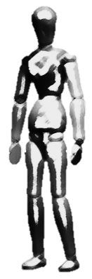


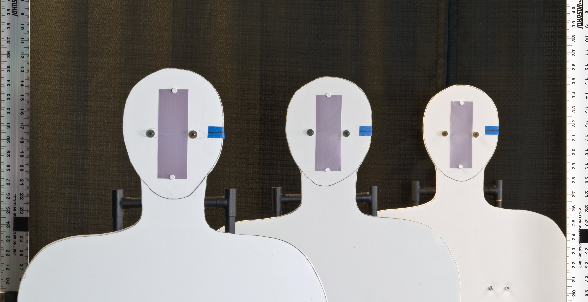
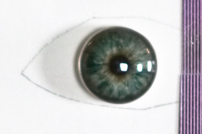

Demonstration of capture volume improvement
0.61 m
0.61 m
4.038 m
Setup
180 mm, F/8
Artificial iris
Ø 11 mm
Camera’s view
Pattern (2 lp/mm)
mm

Slide 2
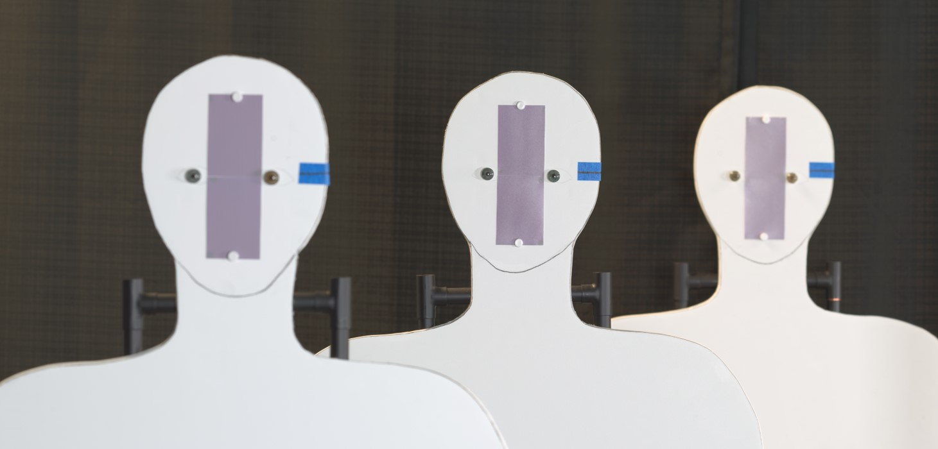
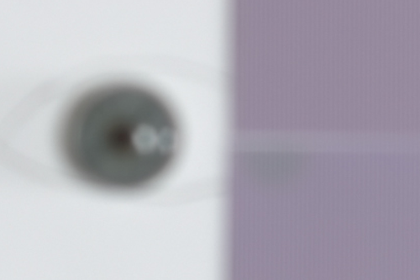
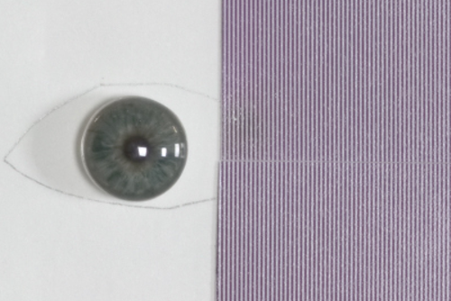
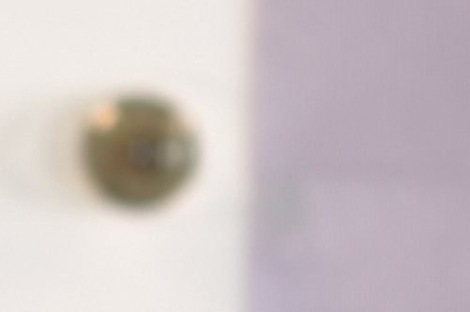
Conventional image capture
Notes:
Write exposure time,

Slide 3
Focal stack

Slide 4
Composite image

Slide 5
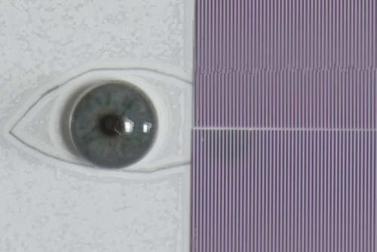
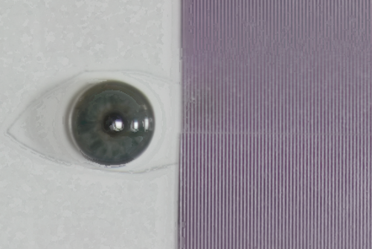
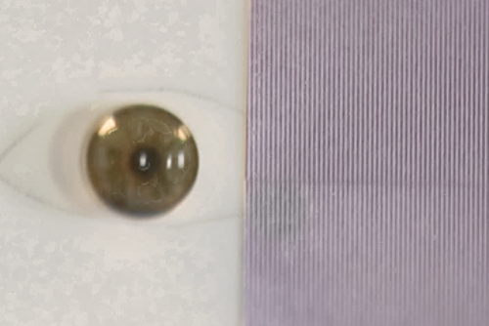
A closer look …
Near (3.43 m )
Middle (4.04 m )
Far (4.65 m )
Conventional @ F/8
Angular Focus Stacking
Notes:
Show before after

Slide 6
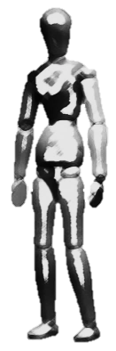
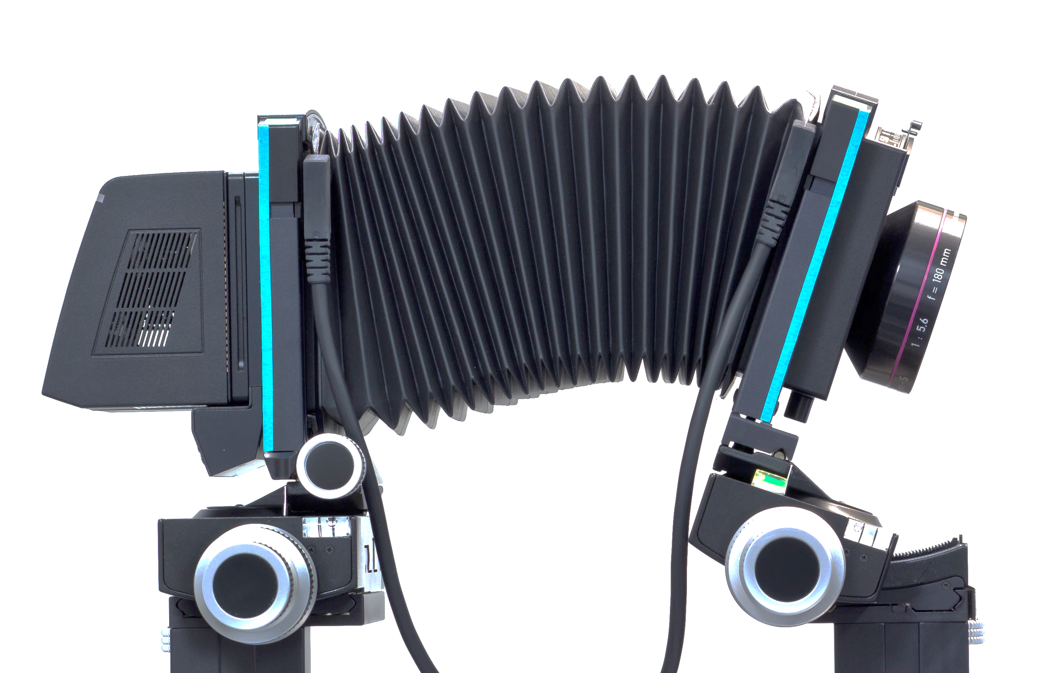
0.61 m
0.61 m
4.038 m
F = 180 mm, Aperture = F/8.
Ø 11 mm
2 lp/mm

